Slide 1


Machine Learning Analysis on various Google Entities
Aditya Kumar Singh-x20140410MSc Data Analytics - Jan 2021, Group BNational College of IrelandDublin, Ireland

Slide 2
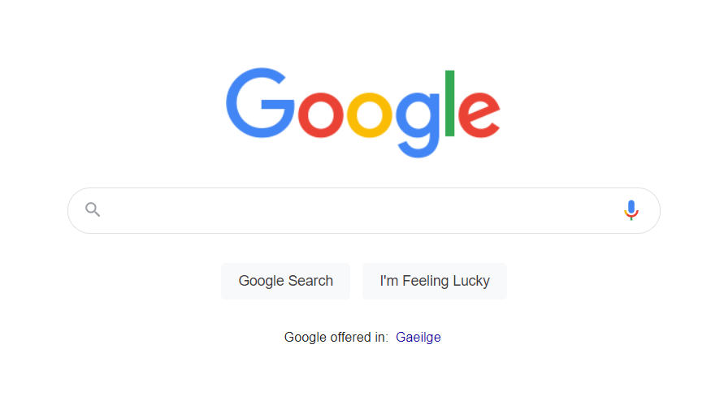
Research Question 1
Can we implement a model to predict the kW of solarpotential for all roof types in a region?

Slide 3
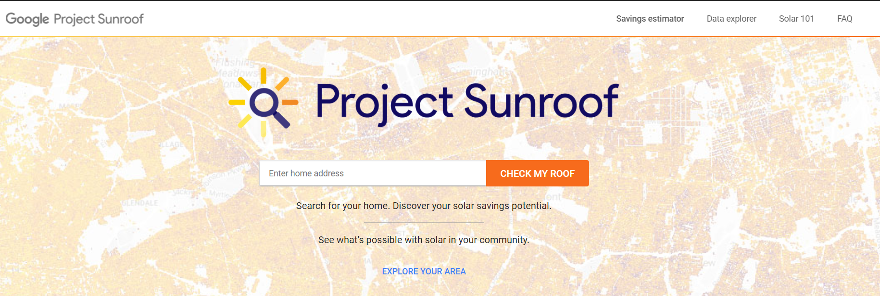
Can we implement a model to predict the kW of solar potential for all roof types in a region?

Slide 4
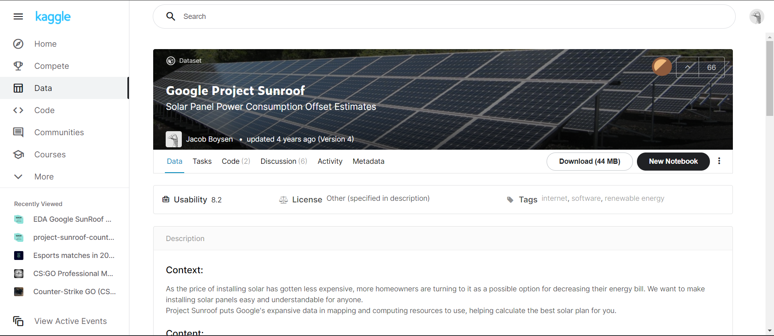

Slide 5
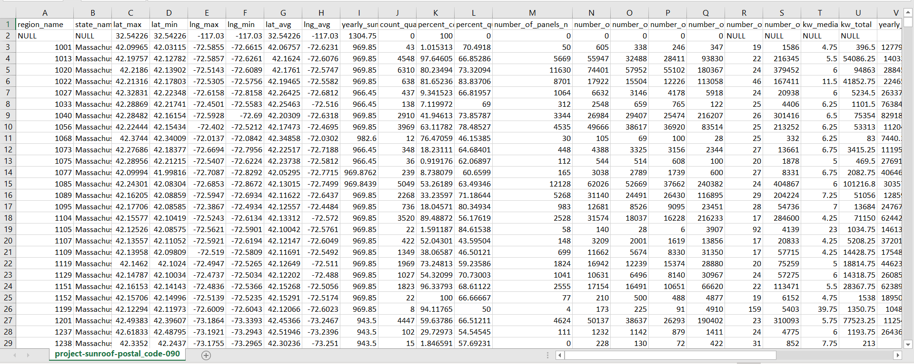

Slide 6
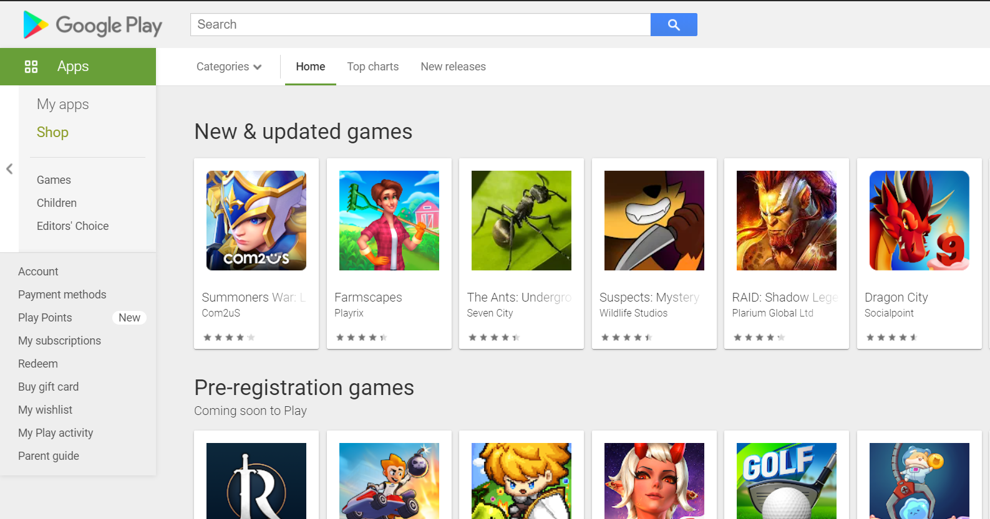
Research Question 1
Can we use a model to predict the user rating for a app among the record?

Slide 7
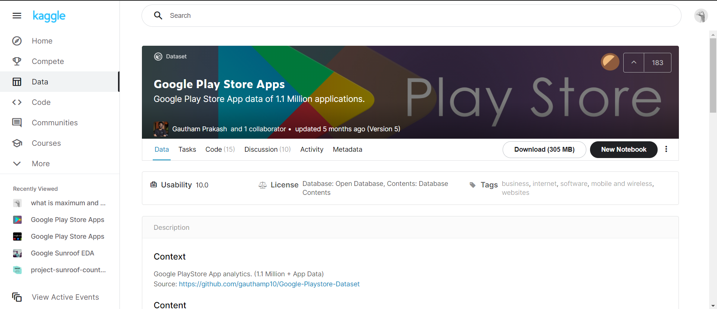
Data Sets

Slide 8
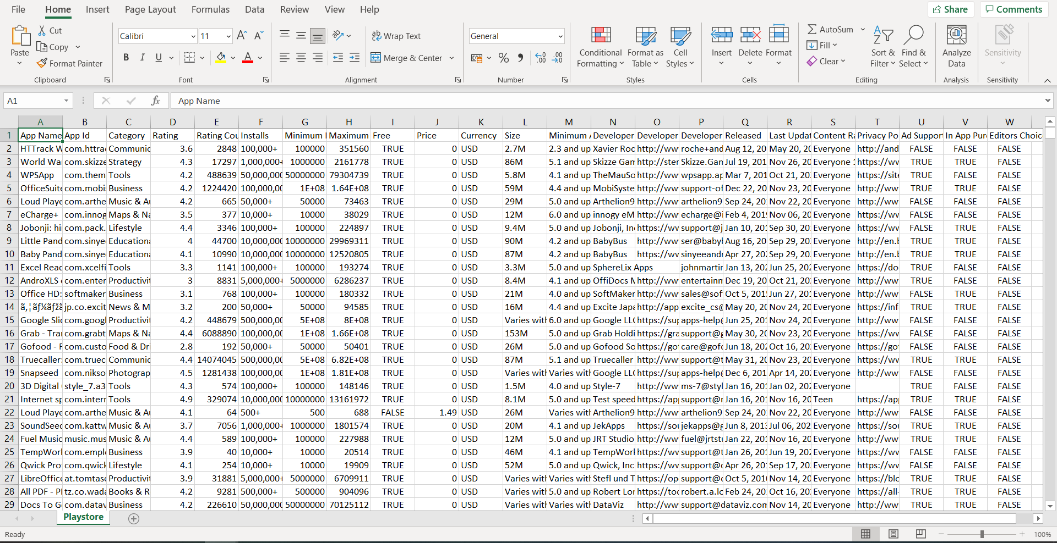

Slide 9
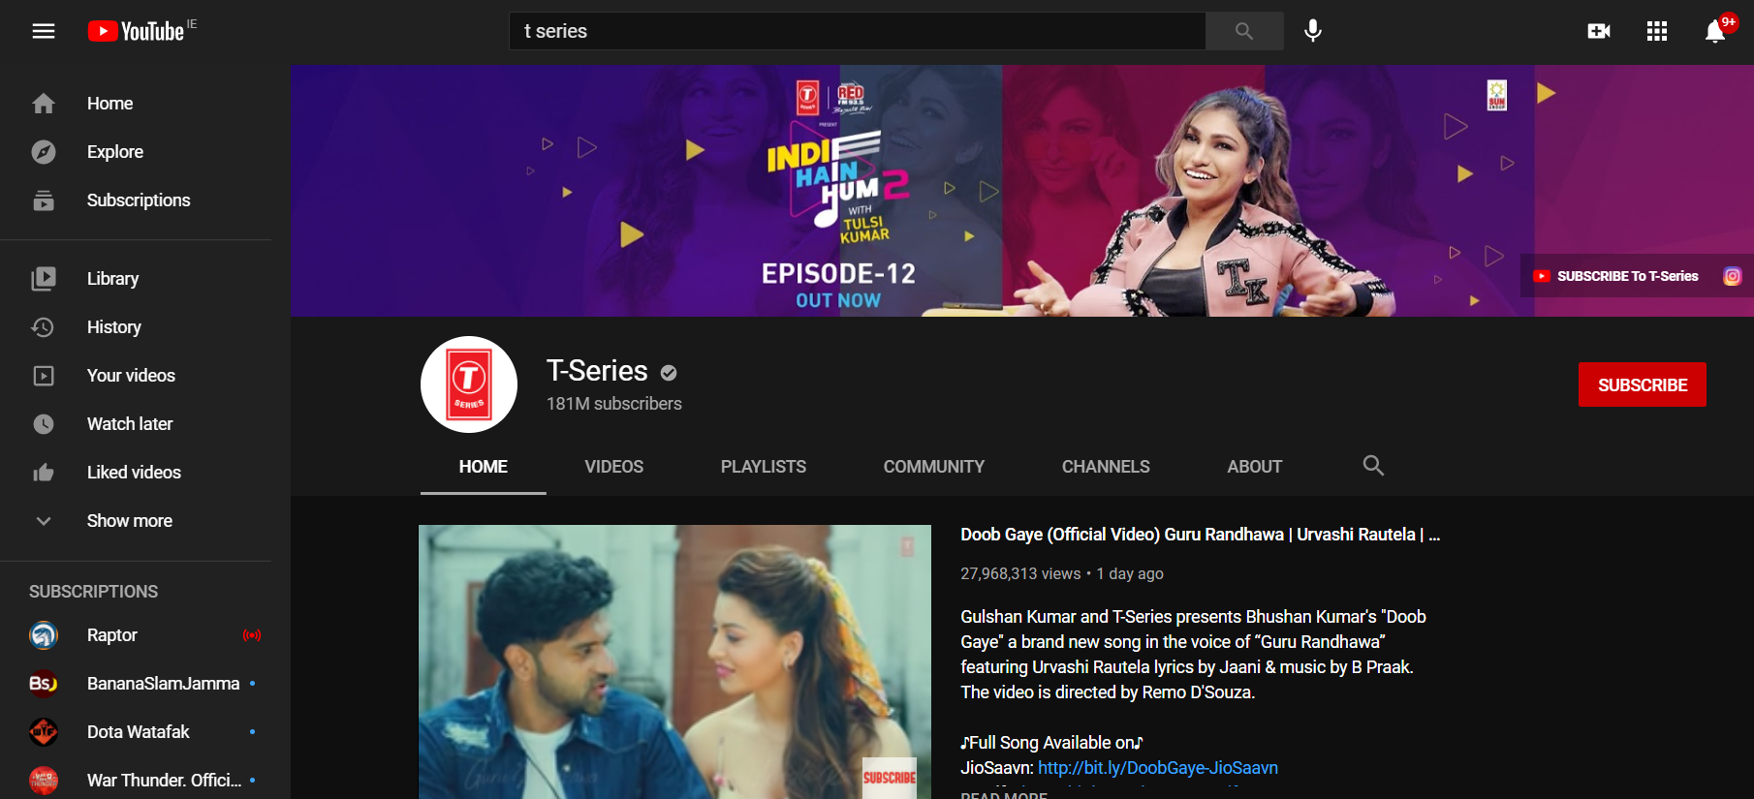
Research Question 1
Can we implement a model to predict the video categoryof a video on channel?

Slide 10
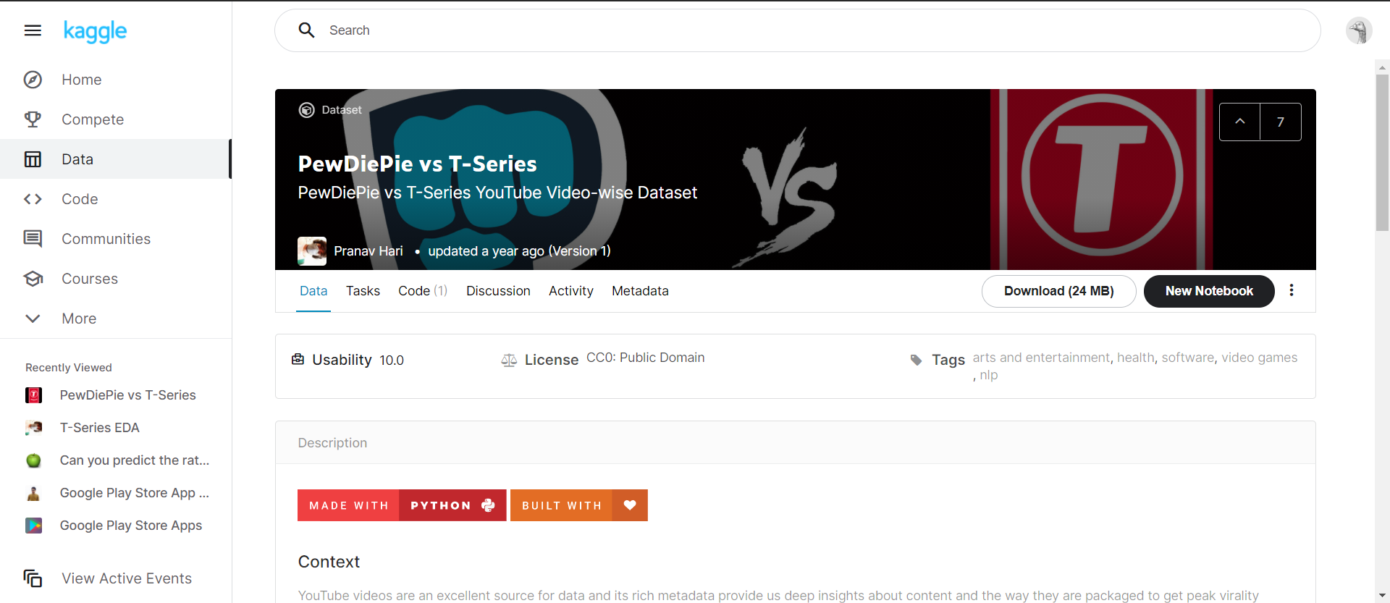

Slide 11
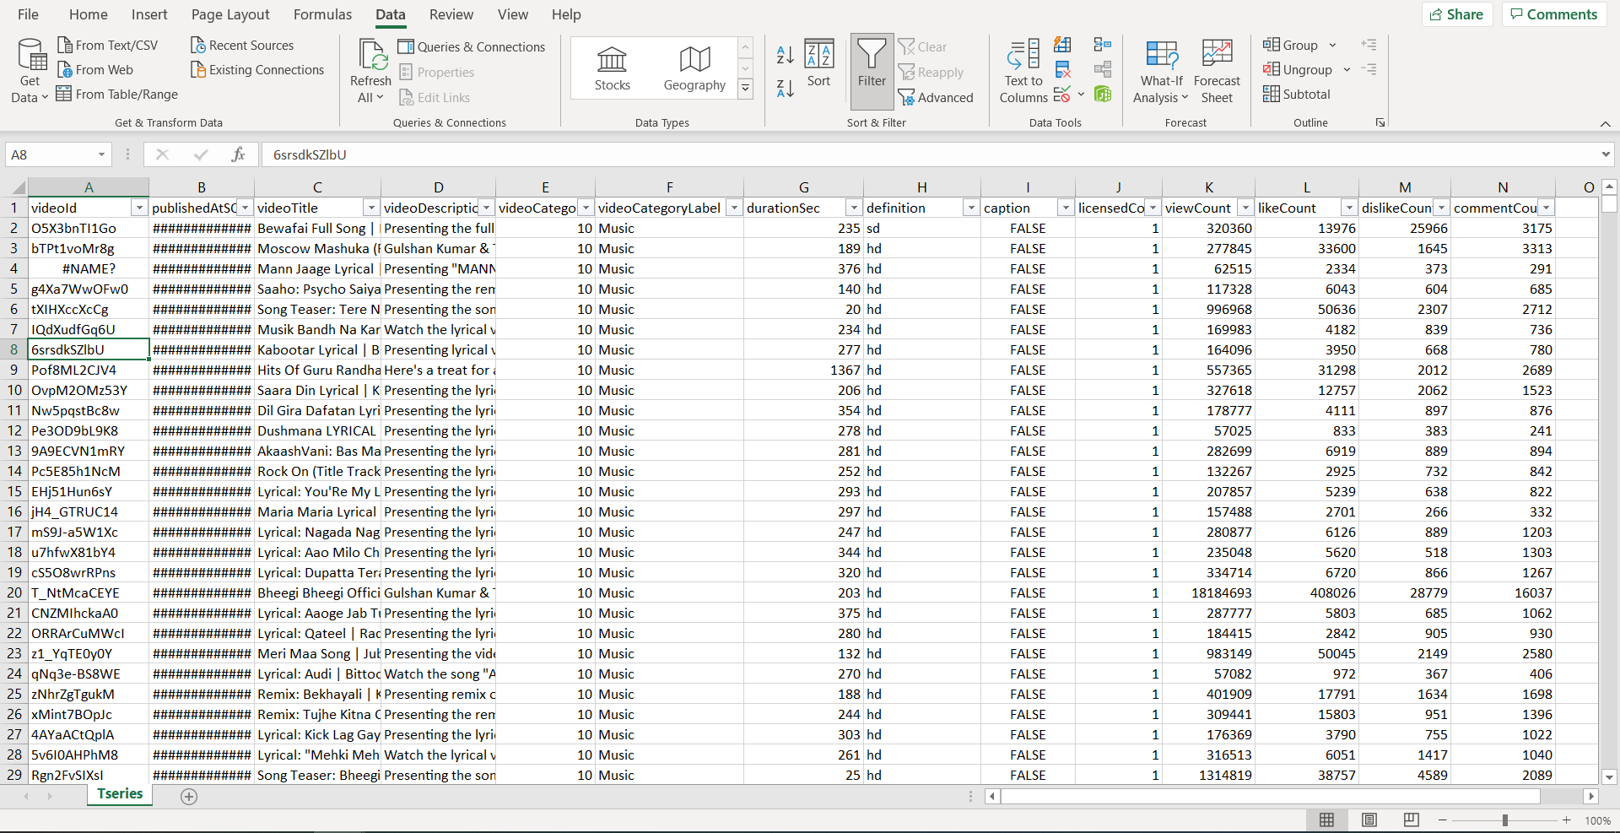

Slide 12
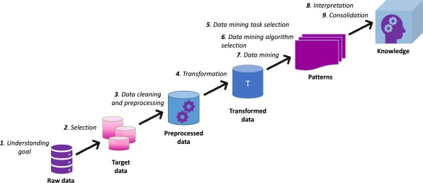
KDD Methodology

Slide 13
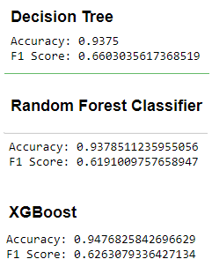
Results YouTube Classification
Best Method Is XGBoost

Slide 14
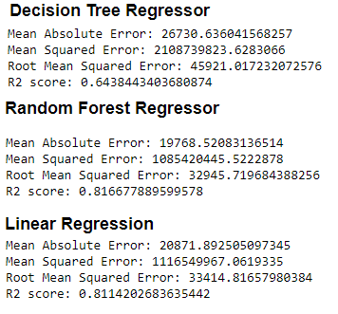
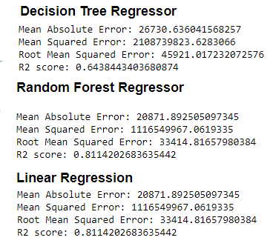
Results Project Sunroof Regression
Best Method Is Random Forest Regressor

Slide 15
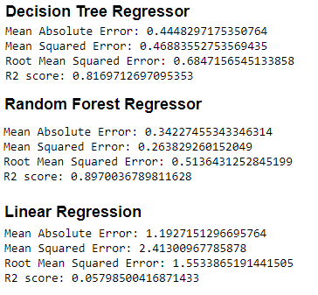
Results Google Play Regression
Best Method Is Random Forest Regressor

Slide 16
THANK YOU

